Slide 1



Level 6, Group 6: Charlie Crew, George Flude, Alexander Polley and Callum Walsh.

Slide 2


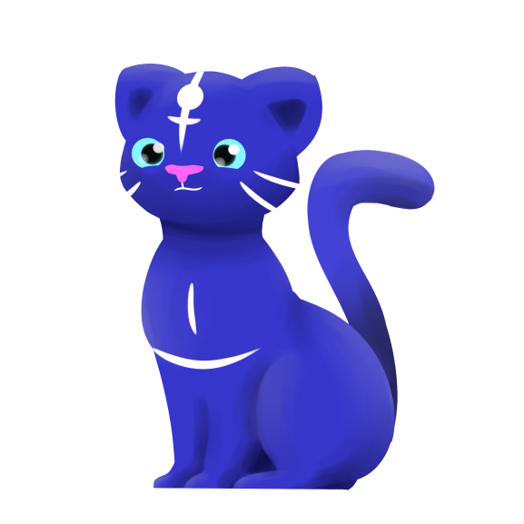

Our brief
Create a casual game that uses minimal input.

Slide 3
Psychograph
Name: Maarii
Age: 48
Occupation: Admin/Sales
Marital Status: Married
Likes:
Chocolates
Toffees
Biscuits
Cats
Dogs
Horses
Dislikes:
Insects
Large Dogs
Scaled Creatures
Heights

Slide 4
Log Line
Bring a world back to life, by colouring, to help Maarii the cat find her friends.

Slide 5




Game Loop
Tap
Reward
Colour

Slide 6
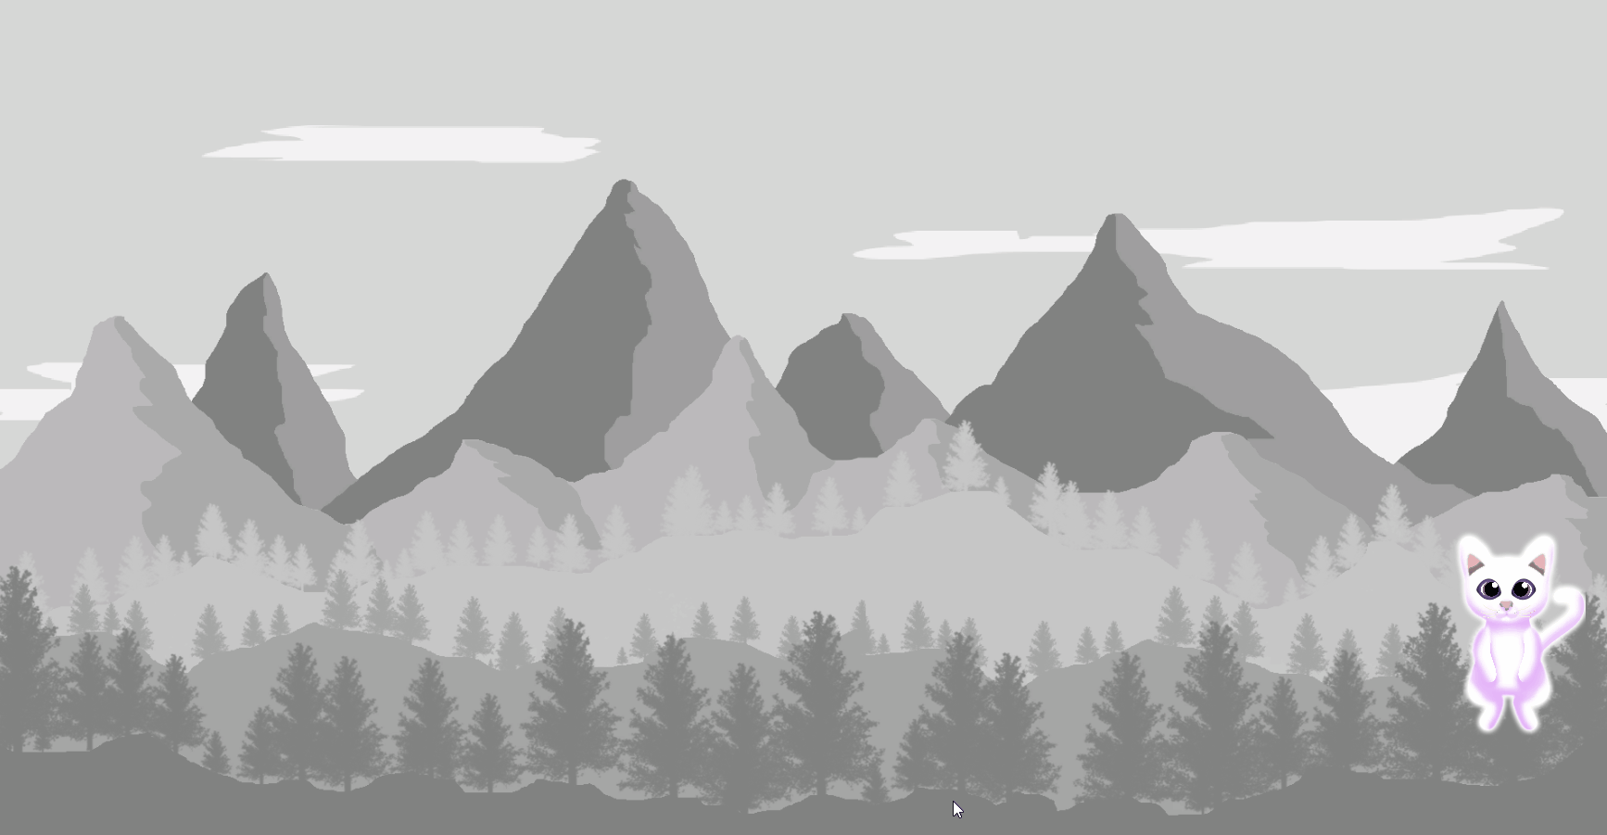
Alpha footage

Slide 7
Alpha User feedback
Simple to play
Visual feedback was satisfying
Would have liked to be able to select own colours

Slide 8
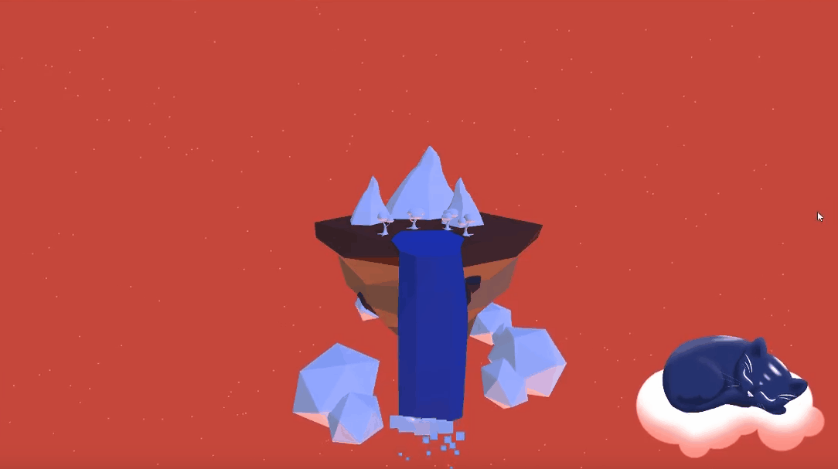
Beta footage

Slide 9
Beta User feedback
3D assests were more please to the eye.
3D Environment created a more immersive experince.
Would have liked to interact with the cat more

Slide 10
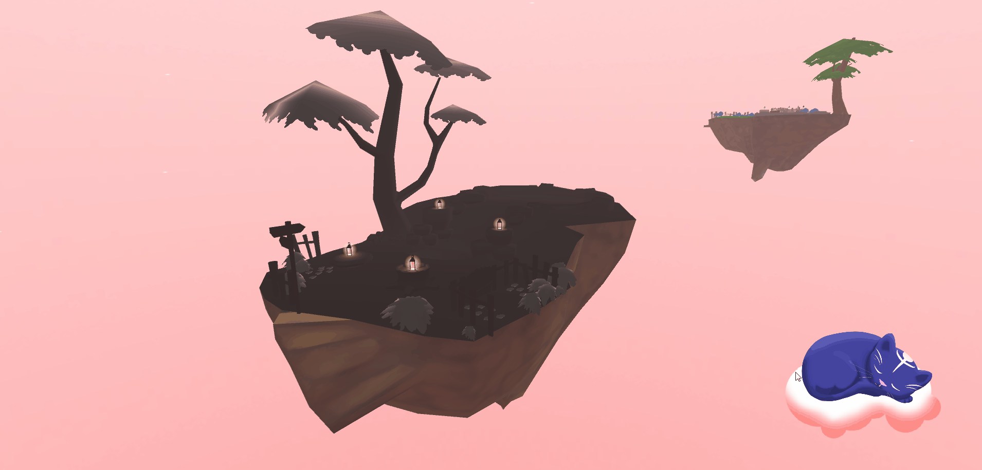
Final Game

Slide 11
Overall What our players liked
Found the art to be visually pleasing.
Enjoyed having to interact with the Cat companion to open the games menu.
Enjoyed the visual feedback that would happen when painting an object.
Enjoyed the simplicity of the controls, weren’t hard to grasp how to play.

Slide 12
Overall What our players disliked
Would have like the Cat companion to have more of a role.
Found certain objects were to small to colour.
Would of liked to have more of a colour selection.
Would of liked to have the ability to Zoom-in closer.
Would of liked to been able to paint more than one single island.

Slide 13
What we thought went well
Game concept was rapidly iterated to suit the brief accordingly
We had a dynamic game loop
Management

Slide 14
What could have gone better
Communication (emails)
Certain aspects of our game weren’t as polished as we would have liked

Slide 15
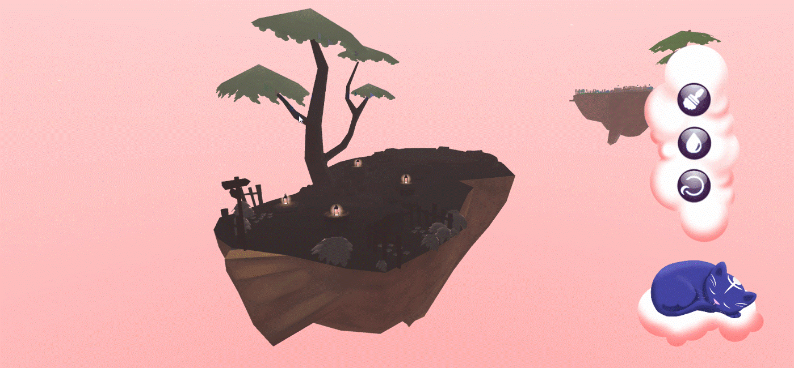
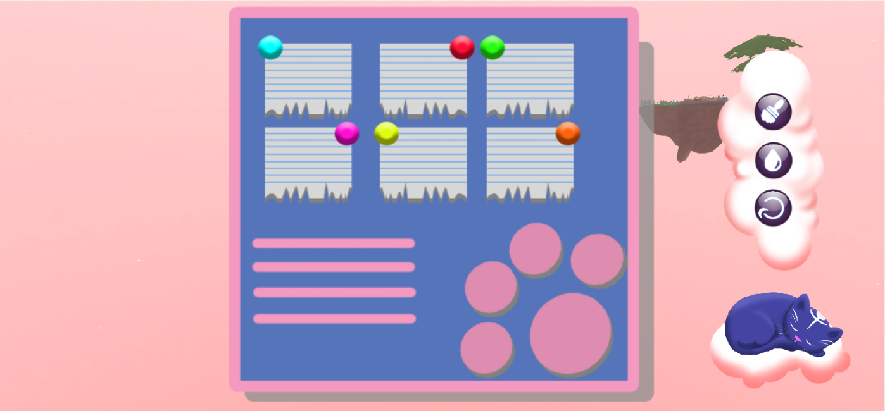
If we were to continue

Slide 16
If we were to continue
We would add the ability to allow the player to zoom.
We would add animations to the cat reacting more to the player’s actions.
We would of liked to add more animal companions.

Slide 17
Management statistics
Overall hours logged (taken from project pivot report):
George: 2w 3d 5h
Alex: 4d 7h
Callum: 1w 3d 5h 45m
Charlie: 4d 2h
Total: 6w 1d 3h 45m

Slide 18
Any questions?

